Slide 1
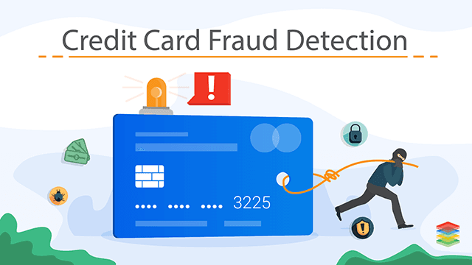
CREDIT CARD FRAUD DETECTION USING MACHINE LEARNING
Notes:
In this presentation, the focus is on detecting credit card fraud with the help of machine learning. Due to the blistering development of online payments, fraud has become a significant issue in terms of money. This paper analyses various machine learning algorithms to identify fraudulent transactions. The project is based on real-world datasets and aims at improving detection accuracy and solving such problems as the imbalance between classes and the evaluation of models.

Slide 2

INTRODUCTION
Expansion of online payment systems.
Increase in credit card fraud.
Weakness of conventional approaches.
Need for intelligent solutions
Notes:
Credit card fraud has increased with the increase in online transactions. The conventional fraud detection systems are based on predetermined rules that do not fit the changing trends of fraud. These systems tend to give a lot of false positives and are not flexible. Thus, fraud detection needs to be done more efficiently and precisely in real-time financial settings with intelligent machine learning solutions.

Slide 3
AIM & OBJECTIVES
Create fraud detection models.
Compare multiple ML algorithms
Address class imbalance issue.
Improve detection accuracy
Notes:
The primary aim of this research is to come up with machine learning models to identify fraudulent transactions. The project is a comparison between Logistic Regression, Random Forest, and XGBoost algorithms. It is also concerned with dealing with the imbalance in classes, which is a significant problem with fraud datasets. The objective is to enhance the quality of detection whilst achieving a balance in precision and recall.

Slide 4
RESEARCH QUESTIONS
Effectiveness of ML in fraud detection
Effects of transaction characteristics.
Best performing algorithm
Suitable evaluation metrics
Notes:
The research questions that are answered in this study include the effectiveness of machine learning models in fraud detection. It also examines what features of transactions make the most contribution towards predictions. The other emphasis is on determining the most successful algorithm amongst the models of choice. Also, the paper investigates the most appropriate evaluation metrics when dealing with imbalanced data.

Slide 5
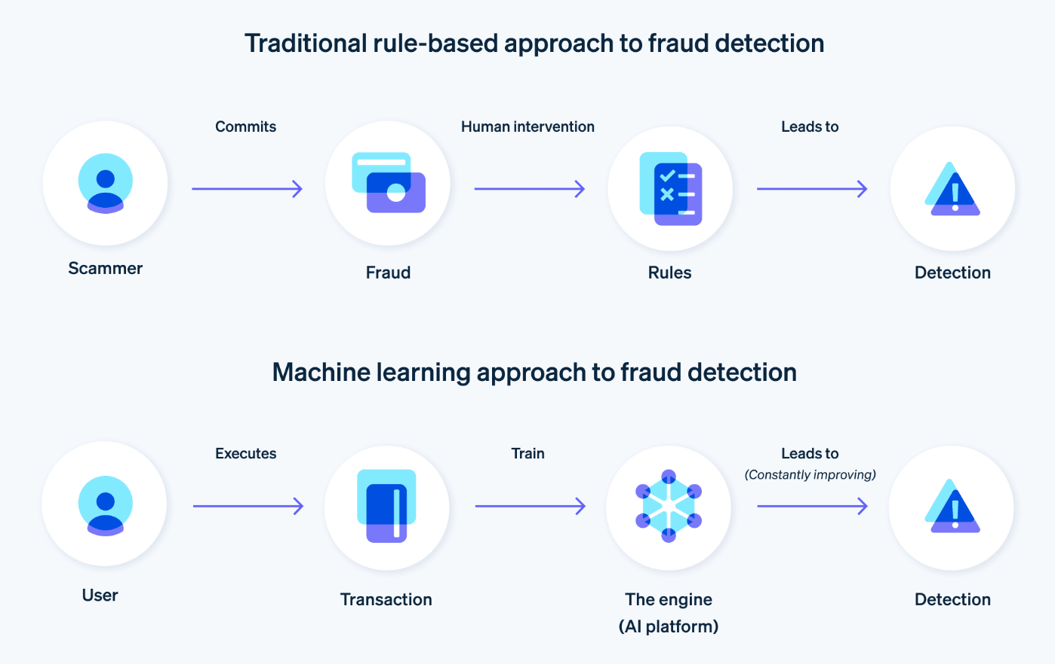
LITERATURE REVIEW
ML vs traditional approaches.
Significance of ensemble models.
Class imbalance challenge
Evaluation beyond accuracy
Notes:
This is indicated in the literature review as the shift to machine learning systems as opposed to conventional rule-based systems. Random Forest and XGBoost ensemble models have performed better. One of the challenges found to be a big challenge is the imbalance of classes, of which fraud cases are very scarce. The review also highlights the use of such measures as precision, recall, and PR-AUC rather than focusing solely on accuracy.

Slide 6
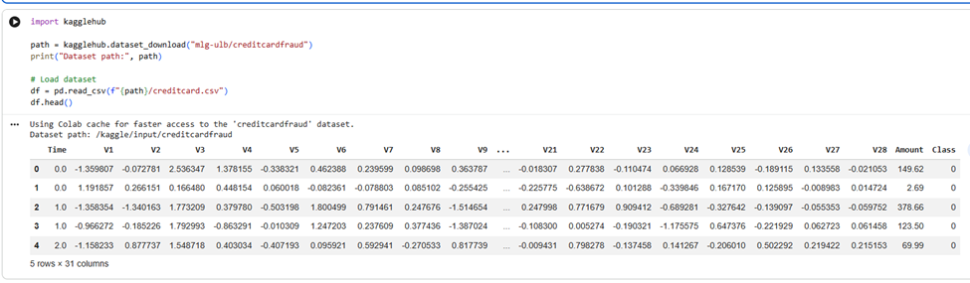
METHODOLOGY
Quantitative experimental design
Use of Kaggle dataset
Data preprocessing techniques
Model training and testing.
Notes:
In the present research, the experimental design is quantitative and is based on a real-life dataset obtained at Kaggle. Preprocessing of data involves scaling and cleaning of features. Stratified sampling is used to divide the dataset into training and testing sets. The performance metrics used to train and evaluate machine learning models are designed to guarantee reliable and unbiased outcomes.

Slide 7
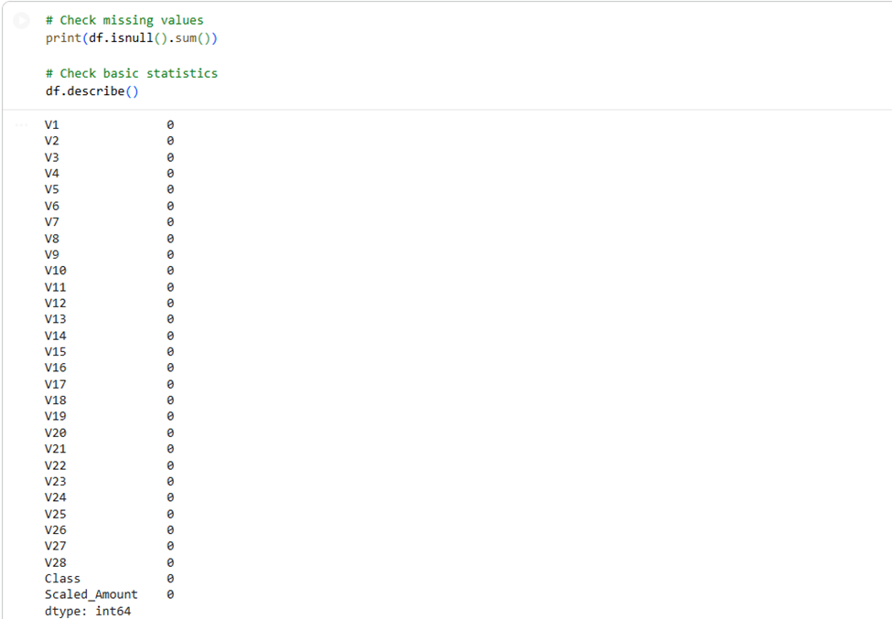
DATA PREPROCESSING
Feature scaling applied
No missing data.
Train-test split (80:20)
Data transformation performed
Notes:
Preprocessing of data plays a very crucial role in this project. The feature scaling is used to bring values to the normal level to enhance the performance of the model. There are no missing values in the dataset, making preprocessing easier. A train-test split of 80:20 is applied with stratification to keep the classes balanced. The transformation of data makes sure that features are valuable when training a model.

Slide 8
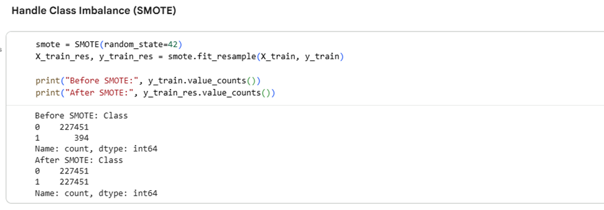
HANDLING CLASS IMBALANCE
There are very few fraud cases.
SMOTE technique applied
Balanced training dataset
Improved model learning
Notes:
The imbalance of classes is a crucial problem in fraud detection, as fraud is very infrequent. To counter this, the SMOTE algorithm is utilised to come up with artificial samples of the minority group. This equalises the dataset and aids models in learning fraud patterns more effectively. Caution is taken, though, to apply SMOTE only to training data to prevent leakage of data.

Slide 9
WHY CLASS IMBALANCE IS A PROBLEM?
Incidents of fraud are very low (~0.17)
Biased model towards the majority class.
Good precision and low fraud detection.
Unnoticed fraud results in loss of money.
Notes:
One of the key challenges in detecting fraud is class imbalance since fraudulent transactions form such a small fraction of the data. Machine learning models are biased towards the majority class, which results in biased predictions. This gives high precision and low fraud detection capabilities. Losses incurred due to failure to detect fraudulent activity can run into millions of dollars, so the imbalance in the dataset must be adequately addressed.

Slide 10
WHY IS ACCURACY MISLEADING?
Minority class is disregarded in accuracy.
Even 99% accuracy will fail.
False negatives are dangerous.
Not applicable to disproportional data.
Notes:
In unbalanced datasets, accuracy is also deceptive as it fails to represent the capacity of the model to identify fraud. Even a model that predicts that all transactions are non-fraud can be very accurate. It, however, does nothing in detecting fraudulent cases. Because it is expensive to detect fraud, it is not appropriate to base it on accuracy. More significant measures are required in order to be properly evaluated.

Slide 11
WHY PR-AUC IS PREFERRED?
Concentrates on the performance of fraud detection.
Is accurate and recalls well.
Appropriate for unbalanced databases.
Simulates behaviour in the real world.
Notes:
PR-AUC is used in fraud detection since it is a measure of the effectiveness of the model on the minority. It takes precision and recall into consideration, making sure to balance between fraud detection and false positives. Compared to accuracy or ROC-AUC, PR-AUC offers a more realistic performance measurement of imbalanced datasets, hence it is more appropriate in this study.

Slide 12
MODEL COMPARISON TABLE
Logistic Regression: low accuracy.
Random Forest: an equal model.
XGBoost: high recall
PR-AUC is most suitable for assessing
Model | Precision | Recall | F1-Score | ROC-AUC | PR-AUC | Key Insights
Logistic Regression | 0.06 | 0.92 | Low | 0.9700 | 0.7667 | High recall but extremely low precision (many false positives)
Random Forest | 0.87 | 0.83 | High | 0.9737 | 0.8746 | Best balance between precision & recall
XGBoost | 0.69 | 0.87 | High | 0.9753 | 0.8736 | Highest overall performance but slightly lower precision
Notes:
This table is a comparison of the three models. Logistic Regression has a good recall but poor precision, resulting in false positives. Random Forest offers middle-ground performance and is trustworthy. XGBoost is highly predictive and recalls well. The best measure in this case is PR-AUC since it can analyse performance on skewed data.

Slide 13
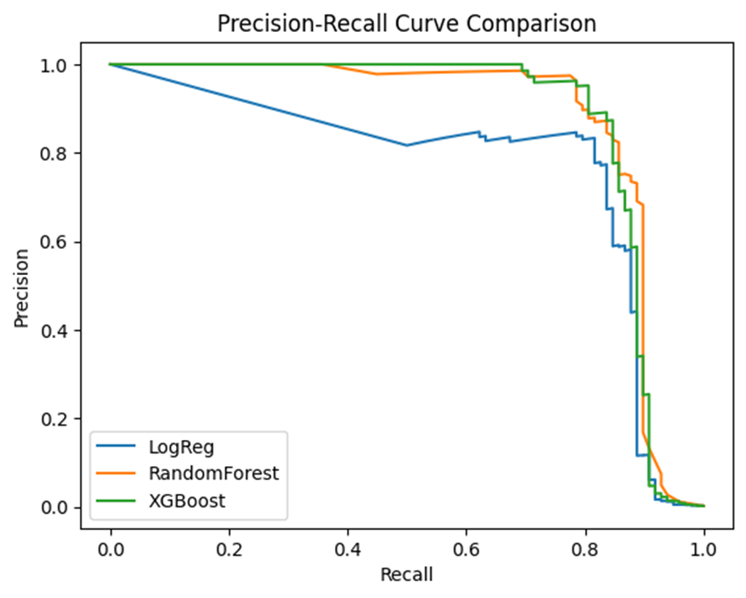
PRECISION-RECALL CURVE
Demonstrates accuracy vs recall trade-off.
Most stable random forest.
XGBoost slightly fluctuates
Logistic Regression is fast to drop.
Notes:
The precision-recall curve is a graph in which the precision is varied with recall. Random Forest performs consistently well over thresholds. XGBoost is good, but with variation. Logistic Regression becomes highly inaccurate, and this means that there are numerous false positives. This discussion explains why ensemble models are more effective at fraud detection than linear models.

Slide 14
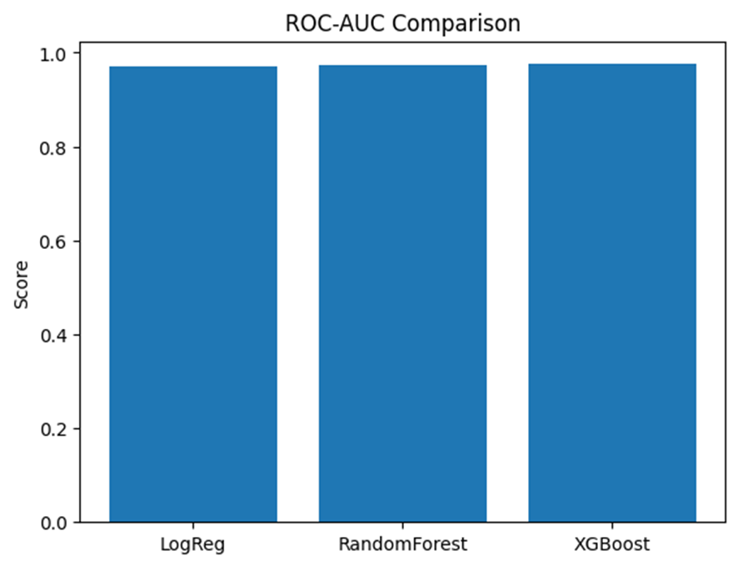
MODEL PERFORMANCE (BAR CHART)
Comparison of models visually.
Random Forest is best balanced.
XGBoost highest recall
Logistic Regression weakest
Notes:
The bar chart plots visually the performance of various models. Random Forest depicts a good balance between precision and recall. XGBoost has high recall, i.e., it is effective in detecting fraud. Logistic Regression is not very precise. Graphical analysis can eloquently explain the reason why ensemble models are better than simple models in detecting fraud cases.

Slide 15
CRITICAL DISCUSSION
Logistic Regression does not work (linear model)
Random Forest is less interpretable.
XGBoost is computationally expensive
Tradeoffs in model choice.
Notes:
All models are limited. Logistic Regression is unable to capture complex patterns because it is linear. Random Forest enhances performance and decreases interpretability. XGBoost is more accurate but needs more computing resources. Thus, the choice of a model will be based on the trade-offs between accuracy, interpretability and efficiency in the application of the model in the real world.

Slide 16
LIMITATIONS
Anonymised dataset
Offline evaluation only
SMOTE overfitting.
No real-time testing
Notes:
There are many limitations of this study. The data is anonymised, which restricts the knowledge of features. Offline evaluation of the models is done, and therefore, performance in real-time is not known. SMOTE has the potential to cause overfitting through artificial data. Also, the system has not been implemented in practice, which restricts the practical validation of the results.

Slide 17

FUTURE WORK
Live fraud protection systems.
Deep learning models
Explainable AI techniques
Advanced imbalance methods
Notes:
In future studies, real-time fraud detection systems can be used to study the practical implementation. The deep learning models can enhance the recognition of complex patterns. Transparency can be enhanced with explainable AI methods such as SHAP. More sophisticated imbalance management techniques like ADASYN can be used to further improve model performance.

Slide 18
ETHICAL CONSIDERATIONS
Users are affected by false positives
Bias in predictions
Data privacy concerns
Need for transparency
Notes:
Fraud detection is sensitive to ethical aspects. False positives can be irritating to users by blocking legitimate transactions. Unfair decisions can be made due to model bias. Working with financial data should be safe to guarantee privacy. Financial systems require transparency, which is a prerequisite to trust and regulatory compliance.

Slide 19
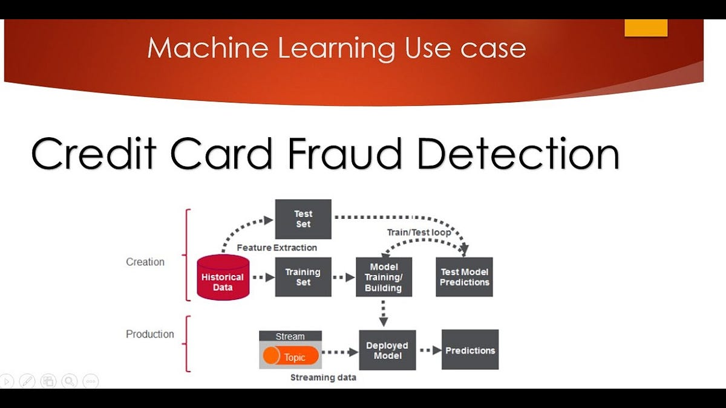
CONCLUSION
ML enhances the detection of fraud.
Handling of class imbalance is important.
XGBoost performs best
Future improvement possibilities.
Notes:
To sum up, machine learning is a valuable tool in the detection of credit card fraud. Class imbalance is a critical issue to deal with to make reliable predictions. XGBoost is the most suitable model of all models tested. Nevertheless, it can be further enhanced, including the implementation of deep learning models and real-time systems. Other areas that can be discussed in future studies are to make the models more interpretable.

Slide 20
REFERENCES
Btoush, E.A.L.M., Zhou, X., Gururajan, R., Chan, K.C., Genrich, R. and Sankaran, P., 2023. A systematic review of literature on credit card cyber fraud detection using machine and deep learning. PeerJ Computer Science, 9, p.e1278.
Chhabra, R., Goswami, S. and Ranjan, R.K., 2024. A voting ensemble machine learning based credit card fraud detection using highly imbalance data. Multimedia Tools and Applications, 83(18), pp.54729-54753.
Dunleavy, P. and Margetts, H., 2025. Data science, artificial intelligence and the third wave of digital era governance. Public Policy and Administration, 40(2), pp.185-214.
Notes:
Btoush, E.A.L.M., Zhou, X., Gururajan, R., Chan, K.C., Genrich, R. and Sankaran, P., 2023. A systematic review of literature on credit card cyber fraud detection using machine and deep learning. PeerJ Computer Science, 9, p.e1278.
Chhabra, R., Goswami, S. and Ranjan, R.K., 2024. A voting ensemble machine learning based credit card fraud detection using highly imbalance data. Multimedia Tools and Applications, 83(18), pp.54729-54753.
Dunleavy, P. and Margetts, H., 2025. Data science, artificial intelligence and the third wave of digital era governance. Public Policy and Administration, 40(2), pp.185-214.
Faraji, Z., 2022. A Review of Machine Learning Applications for Credit Card Fraud Detection with A Case study. SEISENSE Journal of Management, 5(1).

Slide 21
THANK YOU !!

